Slide 2
Mini
Shaunak
Paddy
Kudi

Slide 5
Simplified encoder-decoder architecture
…
…
…
…
Sequence of i/p features
Sequence of o/p tokens
Stack of encoder NNs
Hidden state
Stack of decoder NNs

Slide 6
Encoder RNN

Slide 8
years
recent
in
down
slowed
has
growth
h7: final hidden state
h6
h5
h4
h3
h2
Economic
h1
Encoder RNN
Initial hidden state
h6
h5
h4
h3
h2
h1

Slide 9
years
recent
in
down
slowed
has
growth
h8: final hidden state
h6
h7
h1
h2
h3
h4
Economic
h5
Encoder RNN
h0: Initial hidden state

Slide 10
BACKUP
Decoder RNN
s0
op1 = La
op2 = croissance
op4 = s’est
s3
op3= économique
s1
s2
s4
Mapping process to output
op0
h8: context vector
Encoding process
Economic | growth | has | slowed | down | in | recent | years
La croissance économique s’est ralentie ces dernières années

Slide 11
Decoder RNN
s0
op1 = La
op2 = croissance
op4 = s’est
op7 = dernières
op3= économique
op6 = ces
op5 = ralentie
s8
op8 = années
s3
s1
s2
s6
s4
s7
s5
op0
Mapping process to output
h8: context vector
dernières
années
La
croissance
économique
s’est
ralentie
ces
Encoding process
Economic | growth | has | slowed | down | in | recent | years
t = 8
t = 7
t = 6
t = 4
t = 5
t = 3
t = 2
t = 1

Slide 12








Dot product bw the hidden state and every o/p embedding – returns a set of scalars
SoftMax operation to normalize the scores
$$∙$$
La
= 0.9
= 0.04
$$∙$$
croissance
= 3.7
= 0.73
maximum
s2
$$∙$$
économique
= 0.3
= 0.02
s2
$$∙$$
s’est
= 1.3
= 0.07
s2
$$∙$$
s2
ralentie
= 1.1
= 0.05
s2
$$∙$$
ces
= 0.7
= 0.04
s2
$$∙$$
dernières
= 0.3
= 0.02
s2
$$∙$$
années
= 0.2
= 0.02
s2
Output op3 =

Slide 13
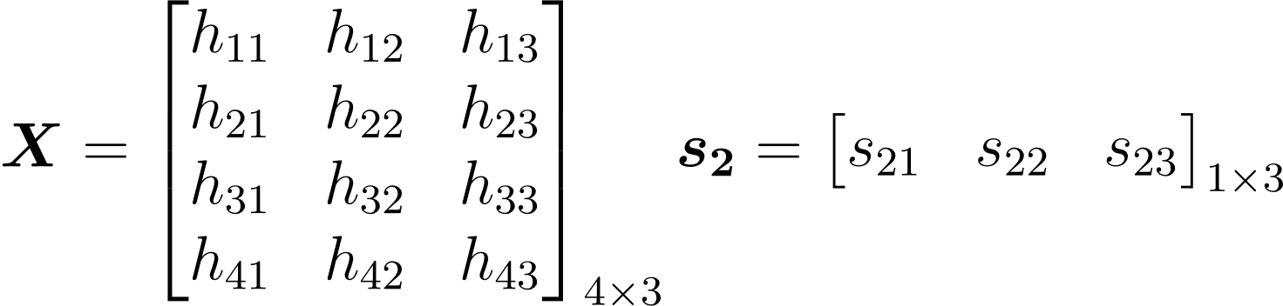

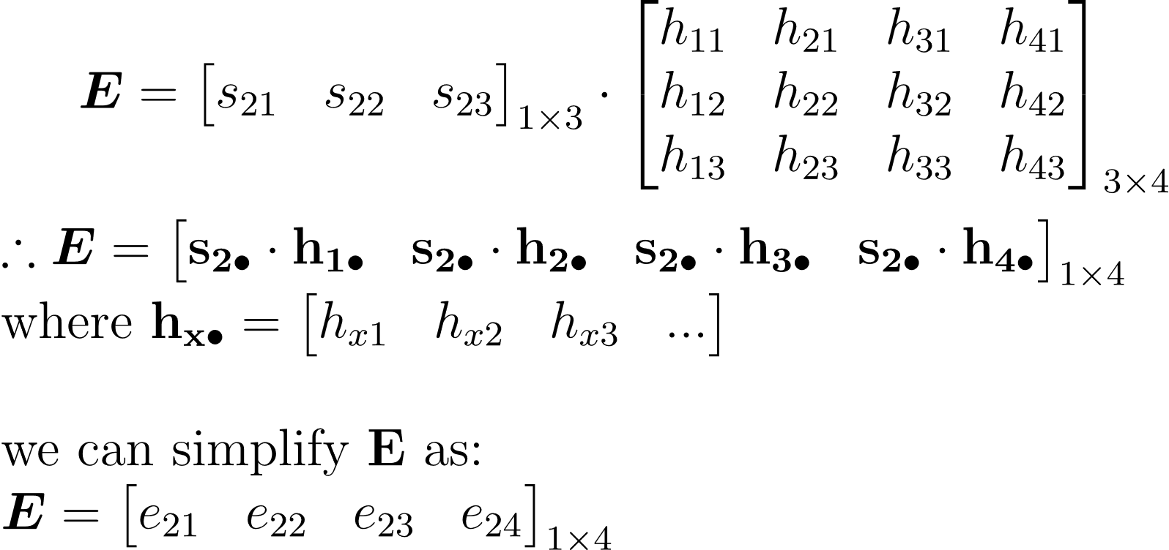
s₂: each hidden state vector (query vector): shape: N_{Q} x D_{Q} (Here N_{Q}=1 and D_{Q}=3)
X: grid of input features (database of keys) : shape: N_{X} x D_{Q} (N_{X} = 4)
e_xy: the wt which is obtained when the xth query vector is applied to the yth input feature (key)
Attn wt : query x key – just like a wt avg

Slide 14
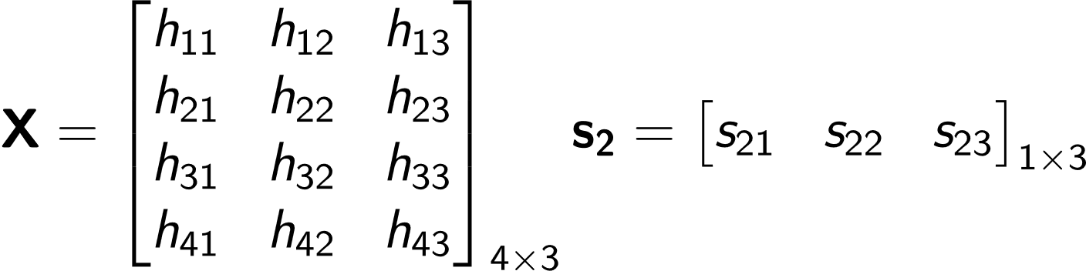
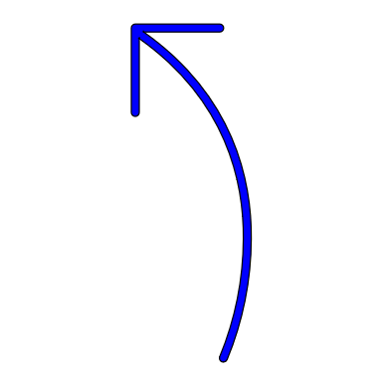
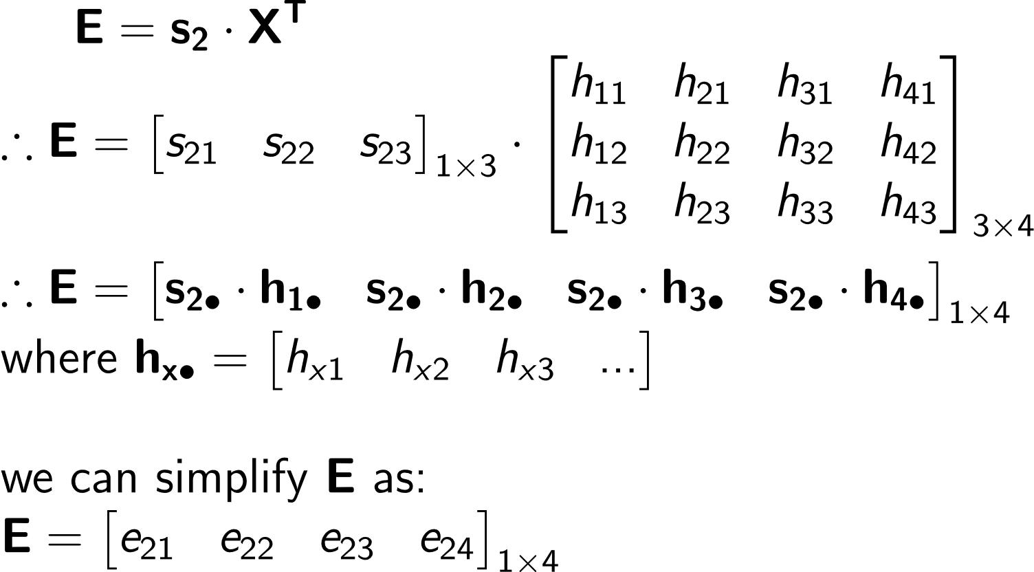
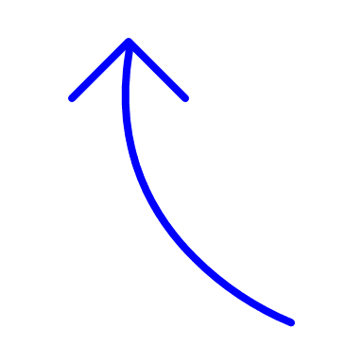
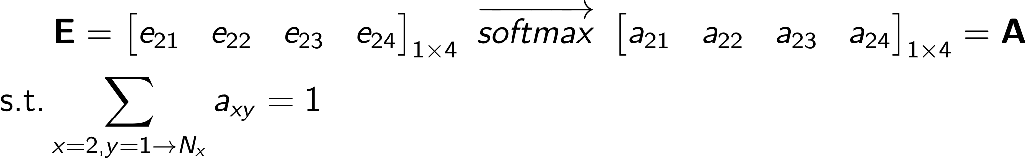
We have a grid of input features X of shape N_{X} x D_{Q} Here N_{X}=4 and D_{Q}=3
We have a hidden state s₂ of shape 1 x D_{Q}
Given this hidden state (query) we want to compute what wt to assign to each input feature (key) in order to generate the output
Step 1: initializing the variables
Raw attention scores
Step 2: computing the raw
Attention weights
Each element is a
scalar (weight)
e_{xy} : how much attention the xth query (hidden state) places on the yth key (feature)
Step 3: normalize the
Attention weights
Normalized attention weight

Slide 15
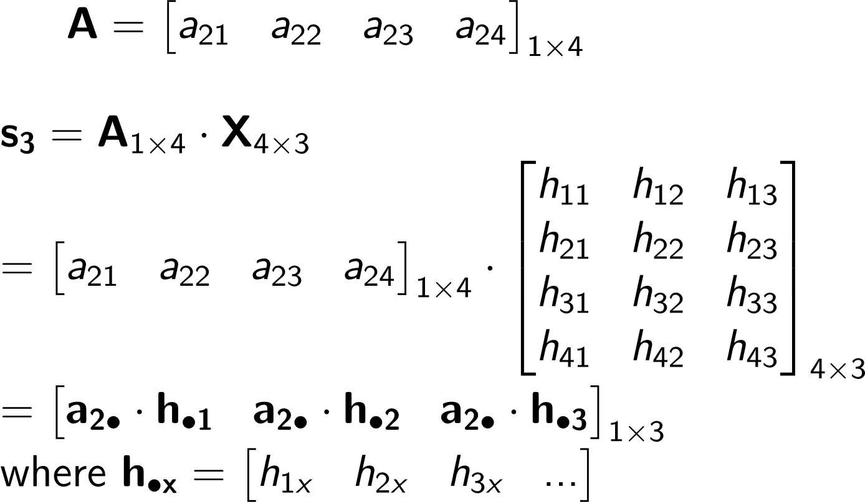
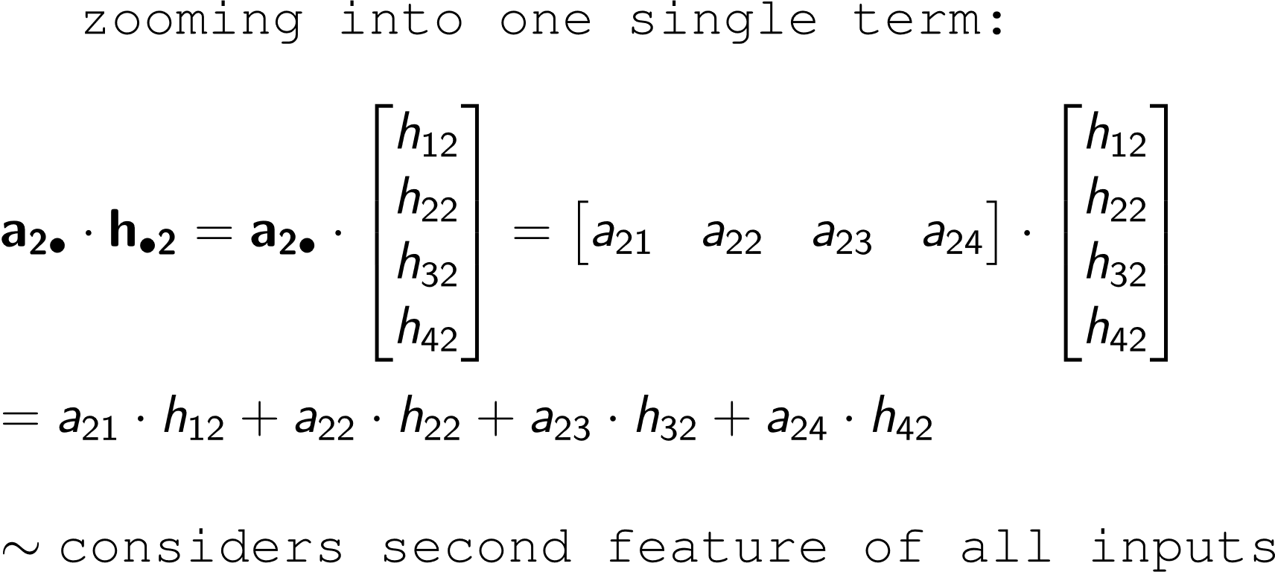
Till now we have computed the attention weights that should be assigned for each key given a query
The next aim is to calculate the new hidden state or the output of the process using these weights
New hidden state
Step 4: computing the raw
Attention weights
NOTE that the dimension of this new hidden state is same as s2 (1 x DQ)
Step 5: Understanding the purpose of attention:
Considers all input features upto a certain extent
The final op is just like a wt. avg over the input features
This eqn looks like a weighted average!
- Essentially, we are figuring out which features are important in what magnitudes

Slide 16
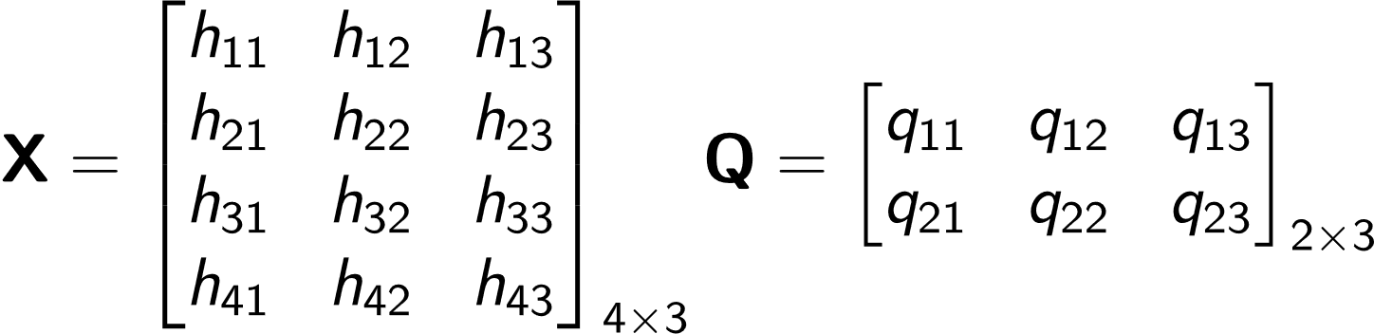
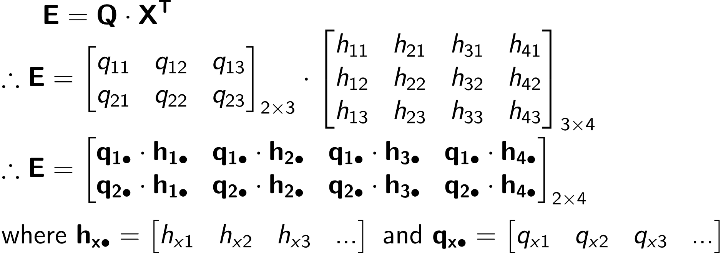
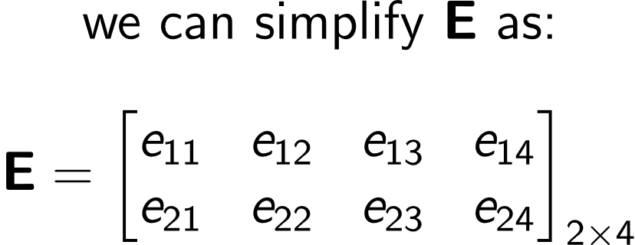
We have a grid of input features X of shape N_{X} x D_{Q} Here N_{X}=4 and D_{Q}=3
Instead of a single query vector, we have a set of query vectors (each of dimension D_{Q} ). So Q is a matrix of queries of shape N_{Q} x D_{Q} (assume N_{Q}=4)
Given a set of queries we want to compute what wt to assign to each input feature (key) in order to generate the output
Step 1: initializing the variables
Raw attention scores
E: Dot product of each query vector with each input feature(key)
i.e. : how similar is each query to a key
Step 2: computing the raw
Attention weights
Each element is a
scalar (weight)
e_{xy} : how much attention the xth query places on the yth key (feature)

